Slide 1
Final Project
Predicting City of Chicago Taxi Fare
Ryan Johnson

Slide 2
Introduction
Dataset
Objective
Data Preprocessing
20 million records of Chicago taxi trip data from 2016
Data was spread into 12 files
Predict the fare for a taxi based on trip_seconds and trip_miles.
Drop missing values
Remove outliers
Optimization & Clustering
Build Models
Model Evaluations
Linear regression with elastic net regularizers, simple tree, random forest, and gradient-boosted tree
Root Mean Squared Error (RMSE) and R squared (R²) to determine the model.
Hyperparameter Tuning
K-Means Clustering

Slide 3
Data Preprocessing: Remove Missing Values
Initial Counts:
fare: 300 missing values
trip_seconds: 3215 missing values
trip_miles: 232 missing values
Using the drop function to remove missing values that exist within fair, trip_seconds, and trip_miles
Verification to ensure missing values have been dropped successfully
fare: 0 missing values
trip_seconds: 0 missing values
trip_miles: 0 missing values

Slide 4
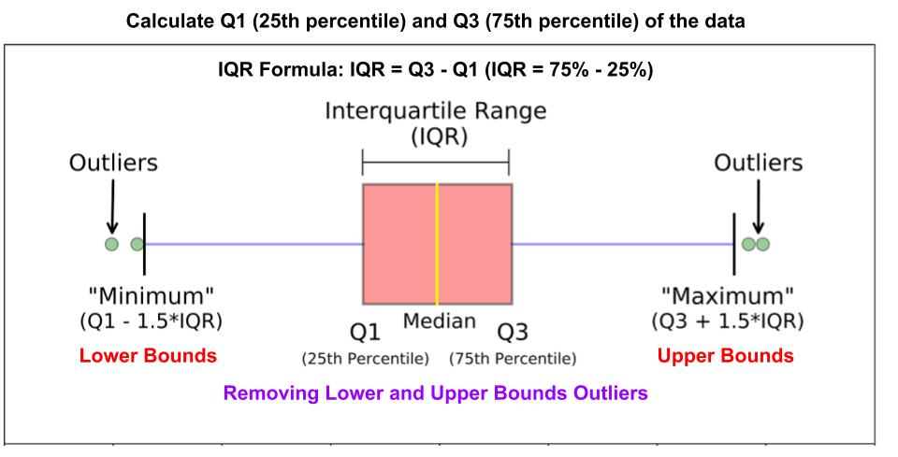
Data Preprocessing: Remove Outliers
Removing outliers to improve model performance so it is not prone to overfitting.
Don’t want data points that fall significantly above or below the other data observations.
Notes:
Link to help understanding how to remove outliers using IQR method: https://medium.com/@karankajrolkar/why-1-5-in-iqr-method-of-outlier-detection-b9301a95c704

Slide 5
Data Transformation
Transform the data into the specific structures required to build the models.
Feature Engineering: VectorAssembler
Merge trip_seconds and trip_miles into a single feature vector called features.
Label Column
Create a separate column label to store fare.
Data Splitting
Randomly split the data into training (70%) and testing (30%) datasets.
A seed value of 25 is needed to reproduce the results.
Notes:
Label and Features:
Label: fare (the target variable for prediction)
Features: trip_seconds and trip_miles (input variables for the model)

Slide 6
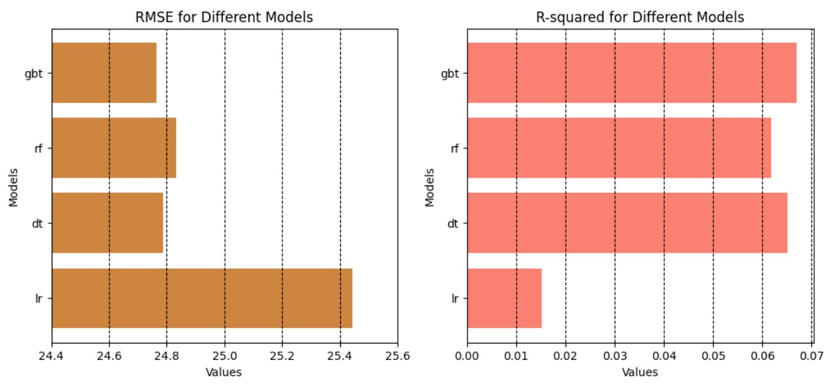
Regression Models and Evaluations
Optimal RMSE
Optimal R²
24.76347
0.06704
-gbt
24.83202
0.06187
24.78811
0.06519
25.44285
0.01515
Lower values indicate better model performance
Higher values indicate better model performance

Slide 7
Regression Models and Evaluations
Optimal RMSE
Optimal R²
24.76347
0.06704
-gbt
The model I recommend using is the Gradient-Boosted Tree (gbt) model.
Gradient-Boosted Tree is the best model of the four regression models:
Linear Regression with Elastic Net Regularizers (lr)
Simple Tree (dt)
Random Forest (rf)
Gradient-Boosted Tree (gbt)
It has the best overall performance for both RMSE and R².
24.83202
0.06187
24.78811
0.06519
25.44285
0.01515
Lower values indicate better model performance
Higher values indicate better model performance

Slide 8
Universal Hyperparameter Tuning
Flexible set of hyperparameters that can be applied to various models
No need to redefine grid parameters should another model outperform the current top choice
Helps automate/streamline the process and ensures consistency
Tuning Specifications
Single hyperparameter used: large dataset (20 million rows)
Train-Validation Split: less expensive
80% training and 20% validation for train ratio

Slide 9
Hyperparameter Tuning
Model Selection
The Gradient-Boosted Tree (gbt) model had the lowest RMSE and highest R squared out of the other models.
Tuning Results: Gradient-Boosted Tree Model Performance
RMSE: 24.76347
R²: 0.06704
Outcome
No improvement occurred
Unchanged compared to the original Gradient-Boosted Tree model.

Slide 10
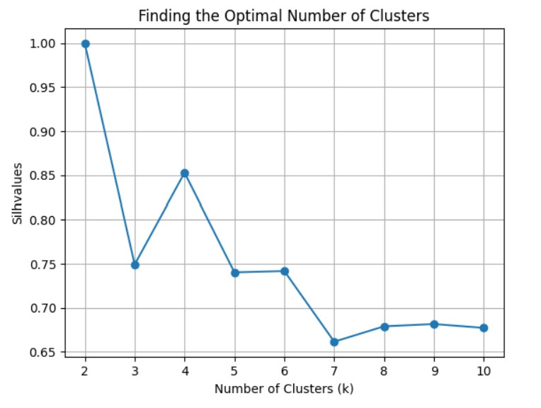
K-Means Clustering: Optimal Clusters
Silhouette Value of 2:
Not optimal
Highest value but oversimplifies the data
Silhouette Value of 4:
Optimal
Second-highest silhouette value
Balances complexity and cluster quality
Avoids oversimplification
Optimal Cluster

Slide 11
K-Means Clustering: 4 Clusters
Silhouette Score:
The optimal silhouette score is 0.85278, which is strong.
The score is close to 1, which indicates well-separated and distinct clusters.
Cluster Centers
Each cluster shows the mean of all points within that cluster:
Cluster 1 Center: [456.8196 1.14222804 8.95469208]
Cluster 2 Center: [2.74980056e+04 1.05866543e+00 5.03902286e+01]
Cluster 3 Center: [1716.65513544 1.93833945 24.66164778]
Cluster 4 Center: [6.58981276e+04 7.37309211e-01 3.06062237e+01]

Slide 12
Conclusion
The Gradient-Boosted Tree (gbt) model is the best-performing model for predicting taxi fare.
Data preprocessing, including dropping missing values and removing outliers, were instrumental in accurate predictions
Future Work:
To provide more context and enhance the model’s performance, additional features could be incorporated from the dataset, including:
tips: Cash tips generally will not be recorded.
tolls: The tolls for the trip
extras: Extra charges for the trip.

Slide 13
Thank You
Does anyone have any questions?

Slide 15


